Slide 1

SINE and COSINE Rule
Exercise 11 C

Slide 2
Triangles that aren’t Right Angled
To find unknown sides and angles in non-right angled triangles we can use one or both of 2 rules:
the sine rule
the cosine rule

Slide 3
The Sine Rule
ABC is a scalene triangle
a, b and c are the sides opposite angles A, B and C
C
b
a
B
c
B

Slide 4
ABC is a scalene triangle
Draw the perpendicular, h, from C to BA.
C
b
a
h
A
c
N
B

Slide 5
ABC is a scalene triangle
C
In
b
b
a
a
h
c
N
B
A
c

Slide 6
ABC is a scalene triangle
C
In
b
a
In
h
A
c
N
B

Slide 7
ABC is a scalene triangle
C
In
b
b
a
In
a
h
h
c
c
N
N
B
A
B
A

Slide 8
ABC is a scalene triangle
In
C
b
b
a
a
h
h
In
c
c
N
B
A
B
A

Slide 9
so,
and
C
b
a
A
c
B

Slide 10
so,
and
C
b
a
A
c
B

Slide 11
The triangle ABC . . .
. . . can be turned so that BC is the base.
We would then get
A
C
b
a
c
b
h
A
c
B
B
a
C

Slide 12
So,
We now have
and
So,

Slide 13
The Sine Rule:
C
b
a
A
B
c
You can only use the Sine Rule if you have a “matching pair”.
You have to know one angle, and the side opposite it.
Then if you have just one other side or angle, you can use the Sine Rule to find any of the other angles or sides.

Slide 14
Finding the missing side:
Not to scale
10cm
x
40°
65°
Is it a right-angled triangle?
No
Is there a matching pair?
Yes

Slide 15
Finding the missing side:
C
Not to scale
b
10cm
a
x
A
40°
c
65°
B
Is it a right-angled triangle?
No
Is there a matching pair?
Yes
Use the Sine Rule
Label the sides and angles.

Slide 16
Finding the missing side:
C
Not to scale
b
10cm
a
x
A
40°
c
65°
B
Because we are trying to find a missing length of a side, the little letters are on top
We don’t need the “C” bit of the formula.

Slide 17
Finding the missing side:
C
Not to scale
b
10cm
a
x
A
40°
c
65°
B
Because we are trying to find a missing length of a side, the little letters are on top
Fill in the bits you know.

Slide 18
Finding the missing side:
C
Not to scale
b
10cm
a
x
A
40°
c
65°
B
Fill in the bits you know.

Slide 19
Finding the missing side:
C
Not to scale
b
10cm
a
x
A
40°
c
65°
B
cm

Slide 20
Finding the missing angle:
Not to scale
10cm
7.1cm
θ°
65°
Is it a right-angled triangle?
No
Is there a matching pair?
Yes

Slide 21
Finding the missing angle:
C
b
Not to scale
10cm
a
7.1cm
A
θ°
c
65°
B
Is it a right-angled triangle?
No
Is there a matching pair?
Yes
Use the Sine Rule
Label the sides and angles.

Slide 22
Finding the missing angle:
C
Not to scale
b
10cm
a
7.1cm
A
θ°
c
65°
B
Because we are trying to find a missing angle, the formula is the other way up.
We don’t need the “C” bit of the formula.

Slide 23
Finding the missing angle:
C
Not to scale
b
10cm
a
7.1cm
A
θ°
c
65°
B
Because we are trying to find a missing angle, the formula is the other way up.
Fill in the bits you know.

Slide 24
Finding the missing angle:
C
Not to scale
b
10cm
a
7.1cm
A
θ°
c
65°
B
Fill in the bits you know.

Slide 25
Finding the missing angle:
C
b
Not to scale
10cm
a
7.1cm
A
θ°
c
72°
B

Slide 26
Solving SAS and SSS Triangles
The Law of Sines was good for
ASA - two angles and the included side
AAS - two angles and any side
SSA - two sides and an opposite angle (being aware of possible ambiguity)
Why would the Law of Sines not work for an SAS triangle?
No side opposite from any angle to get the ratio
15
26°
12.5

Slide 27
We can't use the Law of Sines on these because we don't have an angle and a side opposite it. We need another method for SAS and SSS triangles.
SAS
AAA
You may have a side, an angle, and then another side
You may have all three angles.
This case doesn't determine a triangle because similar triangles have the same angles and shape but "blown up" or "shrunk down"
SSS
You may have all three sides

Slide 28
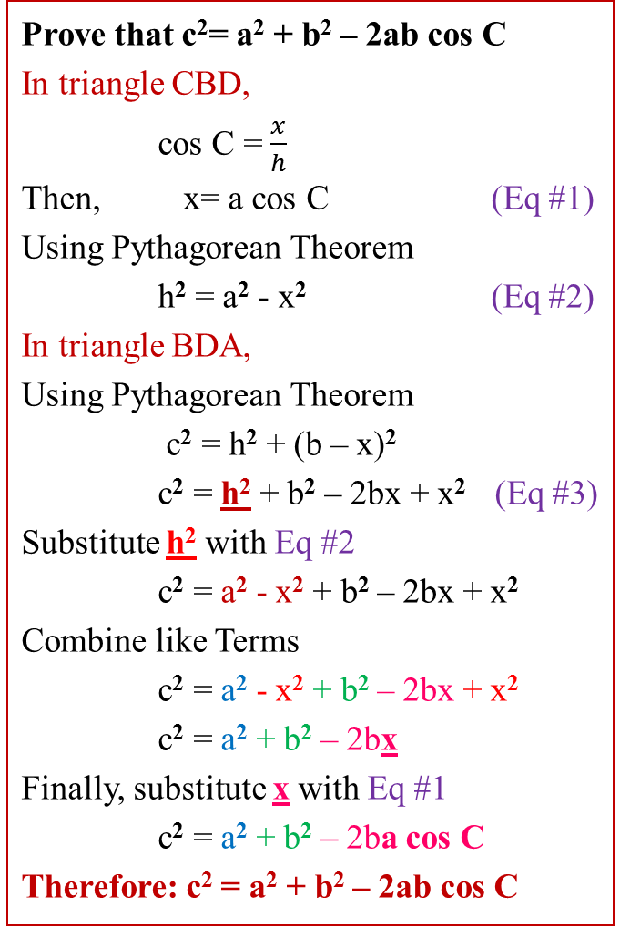
Proof of the Law of Cosines
Prove that c²= a² + b² – 2ab cos C
In triangle CBD,
cos C = $\frac{x}{h}$
Then, x= a cos C (Eq #1)
Using Pythagorean Theorem
h² = a² - x² (Eq #2)
In triangle BDA,
Using Pythagorean Theorem
c² = h² + (b – x)²
c² = h² + b² – 2bx + x² (Eq #3)
Substitute h² with Eq #2
c² = a² - x² + b² – 2bx + x²
Combine like Terms
c² = a² - x² + b² – 2bx + x²
c² = a² + b² – 2bx
Finally, substitute x with Eq #1
c² = a² + b² – 2ba cos C
Therefore: c² = a² + b² – 2ab cos C
B
c
a
h
C
x
D
b - x
A
b
Prove:
c² = a² + b² – 2ab cos C

Slide 29
Introduction

Slide 30
Finding the missing side:
c
Not to scale
A
9km
B
20°
x
a
b
12cm
C
Is it a right-angled triangle?
No
Is there a matching pair?
No
Use the Cosine Rule
Label the sides and angles, calling the given angle “A” and the missing side “a”.

Slide 31
Finding the missing side:
c
Not to scale
A
9km
B
20°
x
a
b
12cm
C
Fill in the bits you know.
x = 4.69cm

Slide 32
Finding the missing side:
A man starts at the village of Chartham and walks 5 km due South to Aylesham. Then he walks another 8 km on a bearing of 130° to Barham.
What is the direct distance between Chartham and Barham, in a straight line?
C
Not to scale
5km
First, draw a sketch.
130°
A
Is it a right-angled triangle?
No
8km
Is there a matching pair?
No
Use the Cosine Rule
B

Slide 33
Finding the missing side:
C
5km
A man starts at the village of Chartham and walks 5 km due South to Aylesham. Then he walks another 8 km to on a bearing of 130° to Barham.
What is the direct distance between Chartham and Barham, in a straight line?
Not to scale
b
a
130°
A
Call the missing length you want to find “a”
a² = 5² + 8² - 2 x 5 x 8 x cos130°
Label the other sides
8km
c
a² = 25 + 64 - 80cos130°
a² = 140.42
B
a = 11.85
11.85km

Slide 34
Finding the missing angle θ:
C
Not to scale
b
a
6cm
9cm
θ°
A
B
10cm
c
Is it a right-angled triangle?
No
Is there a matching pair?
No
Use the Cosine Rule
Label the sides and angles, calling the missing angle “A”

Slide 35
Finding the missing angle θ:
C
Not to scale
b
a
6cm
9cm
θ°
A
c
B
10cm

Slide 36
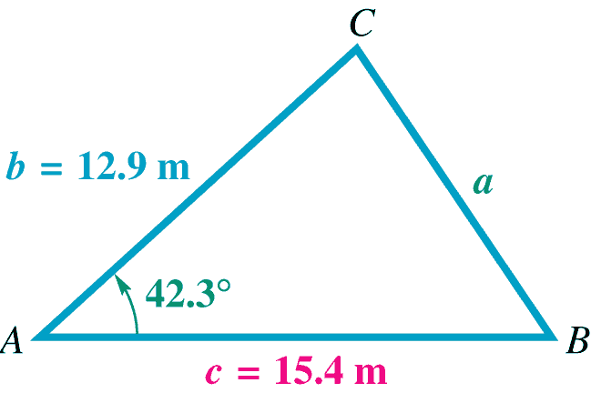
Using the Law of Cosines to Solve a Triangle (SAS)
Example Solve triangle ABC if
A = 42.3°, b = 12.9 meters, and
c = 15.4 meters.

Slide 37


Using the Law of Cosines to Solve a Triangle (SAS)
B must be the smaller of the two remaining angles
since it is opposite the shorter of the two sides b and c.
Therefore, it cannot be obtuse. We use the Law of
Sines to find B.
$$81.7°$$
10.47 m
$$56.0°$$
Caution If we had chosen to find C rather than B, we would not have known whether C equals 81.7° or its supplement, 98.3°.

Slide 38
Using the Law of Cosines to Solve a Triangle (SAS)
Step 1: Use the Law of Cosines to find the side opposite the given angle.
Step 2: Use the Law of Sines to find the angle opposite the shorter of the two given sides. This angle is always acute.
Step 3: Find the third angle. Subtract the measure of the given angle and the angle found in step 2 from 180°.

Slide 39




Using the Law of Cosines to Solve a Triangle (SSS)
Example Solve triangle ABC if a = 9.47 ft, b =15.9 ft, and c = 21.1 ft.
Solution Choose an angle to find.
C
$$109.9°$$
$$b=15.9$$
$$a=9.47$$
B
A
$$c=21.1$$

Slide 40




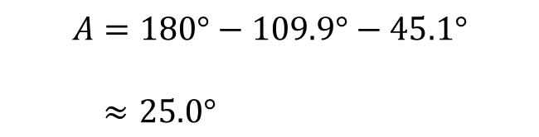


Using the Law of Cosines to Solve a Triangle (SSS)
We will use the Law of Sines to find B.
$$\frac{\sin{B}}{15.9}=\frac{\sin{109.9}}{21.1}$$
$$\sin{B=\frac{15.9∙\sin{109.9}}{21.1}}$$
$$\sin{B=.7085583516}$$
$$\sin^{−1}{.7085583516=45.1°}$$
C
$$109.9°$$
$$b=15.9$$
$$a=9.47$$
$$A=180°−109.9°−45.1°$$
$≈25.0°$
$$45.1°$$
$$25.0°$$
B
A
$$c=21.1$$

Slide 41
Using the Law of Cosines to Solve a Triangle (SSS)
Use the Law of Cosines to find the angle opposite the longest side.
Use the Law of Sines to find either of the two remaining acute angles.
Find the third angle by subtracting the measures of the angles found in steps 1 and 2 from 180°.

Slide 42
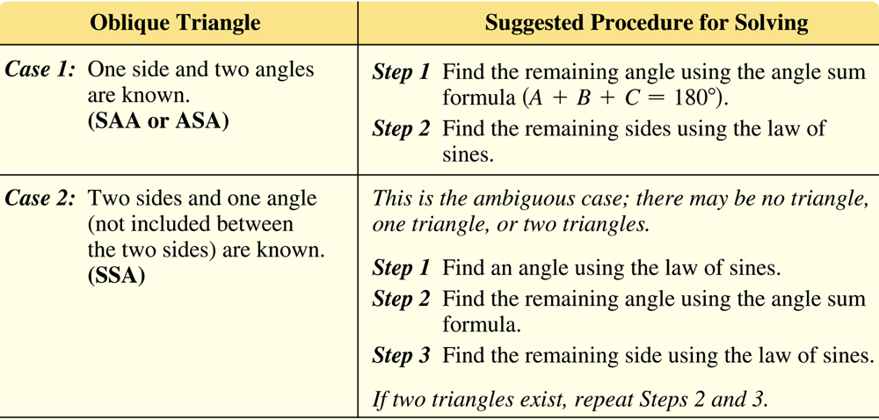
When to use the Law of Sines and the Law of Cosines
Four possible cases can occur when solving an oblique triangle.

Slide 43
